Slide 1

HARNESSING EC2 , VPC & MOBAXTERM FOR CUTTING – EDGE ENTITY HOSTING
PRESENTED BY:
DARSHANASHRI.S
DEVIPRIYA.R
DHANALAKSHMI.D
KEERTHANA.S
KEERTHIGA.K

Slide 2

Harnessing EC2, VPC & MobaXterm for Cutting-Edge Entity Hosting
Unlock the full potential of your web hosting with this comprehensive solution that harnesses the power of Amazon EC2, VPC, and MobaXterm to elevate your online presence and streamline your infrastructure management.

Slide 3
Leveraging the Power of Amazon EC2
Scalability
Flexibility
Reliability
Seamlessly scale your compute resources up or down to meet fluctuating demands, ensuring optimal performance for your web applications.
Choose from a wide range of EC2 instance types and configurations to perfectly match your workload requirements and budget.
Benefit from Amazon's proven track record of high availability and redundancy, ensuring your web services remain online and accessible.

Slide 4
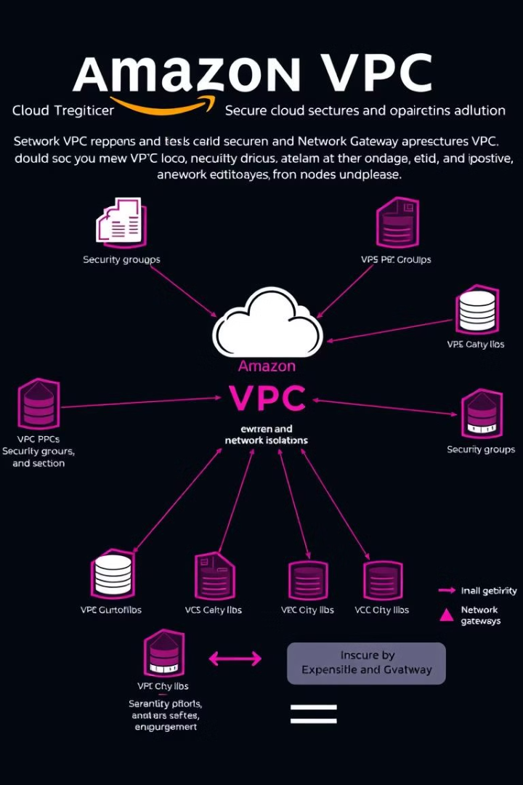
Securing Your Web Presence with VPC
1
Network Isolation
VPC allows you to establish a private, logically isolated section of the AWS cloud, ensuring your resources are protected from external threats.
2
Access Control
Granular control over network access, routing, and security groups enables you to enforce strict security policies and safeguard your infrastructure.
3
Compliance
VPC helps you meet regulatory and industry requirements by providing a secure and isolated environment for your web applications.

Slide 5
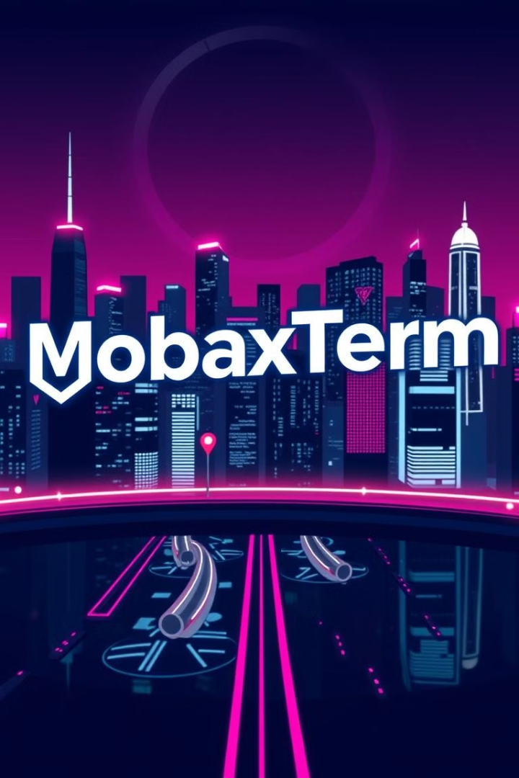



Streamlining Remote Access with MobaXterm
Terminal Emulation
Seamlessly connect to your EC2 instances and perform administrative tasks through a feature-rich terminal emulator.
Secure File Transfer
Easily transfer files between your local machine and your EC2 instances using MobaXterm's intuitive file transfer interface.
Remote Desktop
Gain remote access to your EC2 instances through MobaXterm's secure and user-friendly remote desktop functionality.

Slide 6

Optimizing Infrastructure for Scalability
Auto Scaling
Load Balancing
Automatically scale your EC2 instances up or down based on pre-defined metrics, ensuring your web applications can handle fluctuating traffic demands.
Distribute incoming traffic across multiple EC2 instances, improving overall system availability and responsiveness.
Monitoring
Leverage AWS CloudWatch to monitor your infrastructure's performance and receive alerts for potential issues, enabling proactive optimization.

Slide 7

Enhancing Security and Compliance
Regulatory Compliance
Data Encryption
Align your infrastructure with industry standards and regulations, such as HIPAA, PCI DSS, and GDPR, to maintain compliance and mitigate legal risks.
Ensure the confidentiality of your sensitive data by leveraging AWS's robust encryption capabilities, both at rest and in transit.
1
2
3
Network Security
Benefit from the built-in security features of VPC, including security groups, network ACLs, and route tables, to control and protect your network traffic.

Slide 8
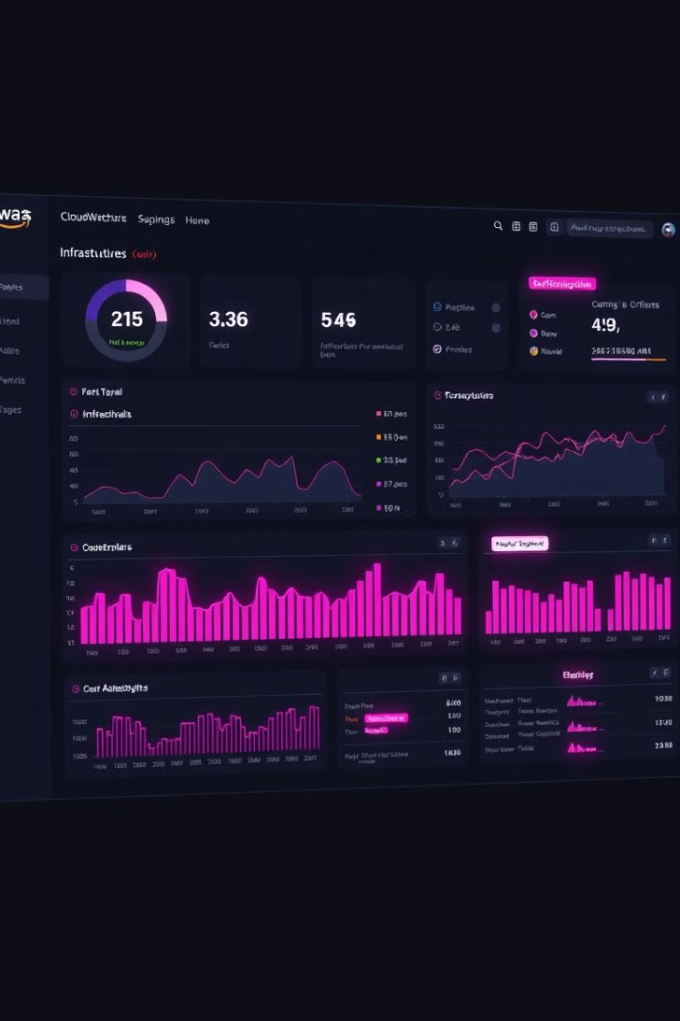
Monitoring and Maintaining your Hosting Environment
1
Performance Monitoring
2
Automated Alerts
Set up custom CloudWatch alarms to receive timely notifications about potential issues, enabling you to address problems proactively before they impact your web services.
Leverage AWS CloudWatch to track crucial metrics, such as CPU utilization, network traffic, and disk I/O, to identify performance bottlenecks and optimize your infrastructure.
3
Maintenance Automation
Streamline routine tasks, such as software updates and security patches, using AWS automation tools to ensure your hosting environment remains up-to-date and secure.

Slide 9

Conclusion and Next Steps
By harnessing the power of Amazon EC2, VPC, and MobaXterm, you can elevate your web hosting to new heights, ensuring scalability, security, and seamless remote management. Take the first step towards transforming your online presence and get in touch with us to explore how this comprehensive solution can benefit your organization.

